Slide 1
Building REST APIs with
Python & Flask
SERAVANA KUMAR POTHUKUCHI

Slide 2
Overview
What is Restful API
Features of Restful API
Python and Flask for APIs
Testing Restful APIs
Real Time App – Employee Directory
  Application Architecture
  Setting Up Environment
  Creating Endpoints Template
  Database Integration
  Business logic

Slide 3
What is Restful API
A RESTful API(Representation State Transfer API) is an application programming interface that adheres to the principles and constraints of REST architecture. It is used to enable communication between client and server over HTTP.
Benefits:
  Scalability
  Simplicity
  Caching support
  Platform and language independence

Slide 4
Features of Restful API
Stateless: Each request from the client to the server must contain all the necessary information. The server does not store any session information.
Client-Server Architecture: The client and server operate independently. The client only handles the user interface, while server handles data processing and storage.
Uniform Interface: Resources are accessed via consistent, predictable URIs
Use of HTTP methods: GET, POST,PUT, DELETE
Resource-Based:Everything is treated as a resource, represented in JSON or XML format
Stateless Communication: No client context is stored on the server between requests.

Slide 5
Why Python & Flask in Restful API
Large Standard Library & Ecosystem:
  Python has a vast range of libraries and tools that spread up development.(requests,json,sqlalchemy)
Cross-platform & Versatile:
  Python runs on all major platforms and is widely used in web development, data science, automation and more
Lightweight & Minimalist:
  Flask is micro-framework. It doesn’t force a particular project structure giving you full control over your application
Easy to Build REST APIs:
  With Flask’s simple routing and HTTP method calling, you can build REST endpoints quickly with minimal code.
Extensible:
  Flask supports plugins and extensions(eg: for authentication, databases, CORS etc)
Built-in Development Server & Debugger:
  Flask comes with tools that make development and testing easy and fast
Popular in Prototypes and Production:
  Flask is used both for quick MVPs and in production by companies like Netflix, Reddit and Lyft.

Slide 6
Questions?
Scalability in terms of RestAPI
How effectively can we create model in Image-based API using API built from python or flask?
Flask or FastAPI
FastAPI Vs RESTAPI
Flask is better than Python

Slide 7
Build a prototype of Real Time Project using RestAPI
Employee Directory
  Features:
    CRUD Operations
    Data Validation
    Error Handling

Slide 8
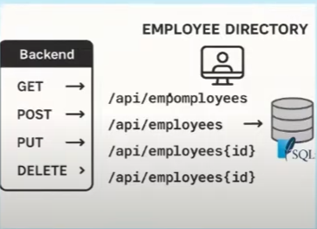
Application Architecture
Overview:
This application allow to perform all CRUD operations as below:
  Save the employee details
  Retrieve the employee and employee details
  Update the employee details
  Delete the employee details
  NOTE: SQLite database is used.

Slide 9
Setting up Environment
Software/Tools Needed:
Python with version 3.x installed
Install virtualenv through pip(pip install virtualenv)
Postman to test the APIs
Any IDEs that support python extension(eg:pycharm)
Install the packages:
Pip install flask
Pip freeze > requirements.txt

Slide 10
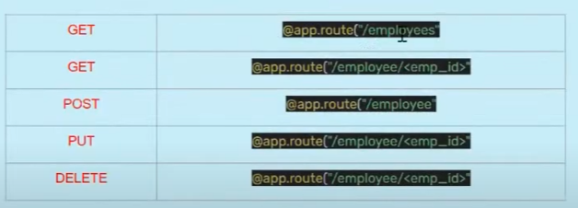
Endpoints Template

Slide 11
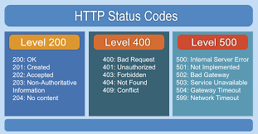
Error Codes:

